Slide 1
Backup and Restore
Lecturer: Ngo Huy Bien
Software Engineering Department
Faculty of Information Technology
VNUHCM - University of Science
Ho Chi Minh City, Vietnam
nhbien@fit.hcmus.edu.vn

Slide 2

Objectives

Slide 3

Contents

Slide 4

References

Slide 5
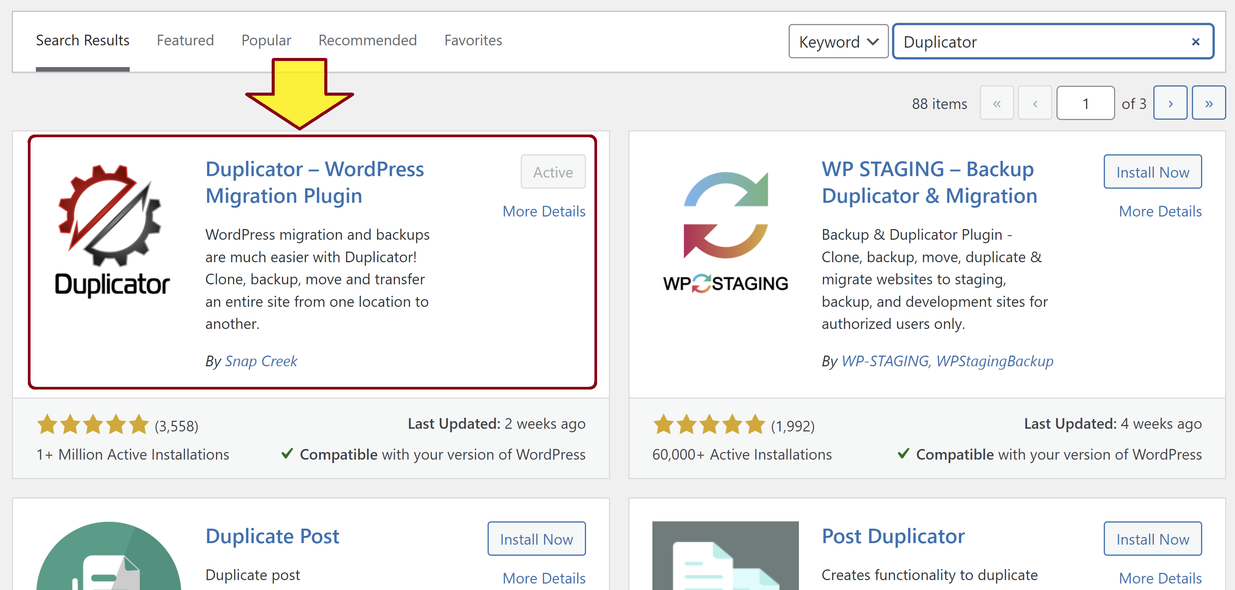
1. Install the Duplicator Plugin
Install and activate the Duplicator plugin.

Slide 6
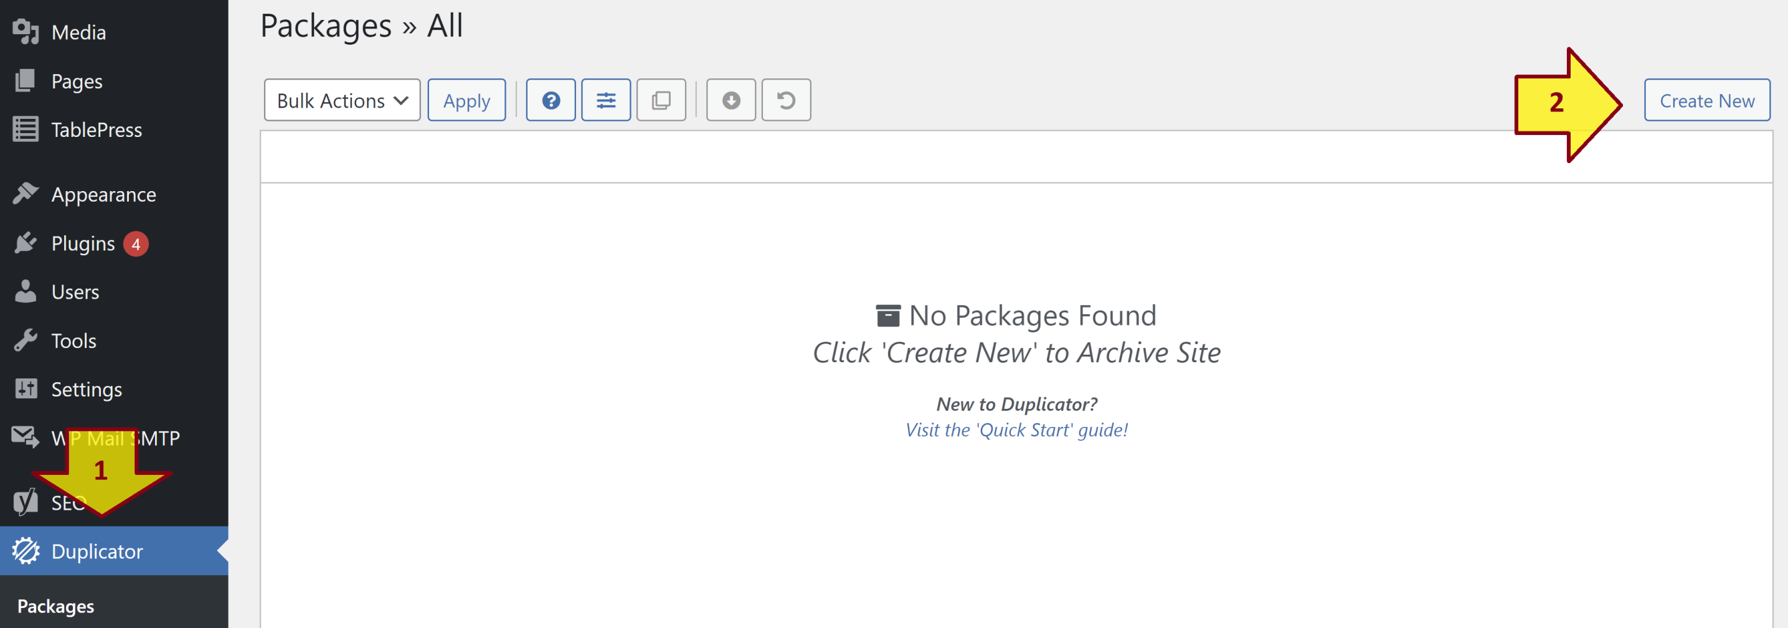
2. Create a Package
Click the Create New button to create a package.

Slide 7
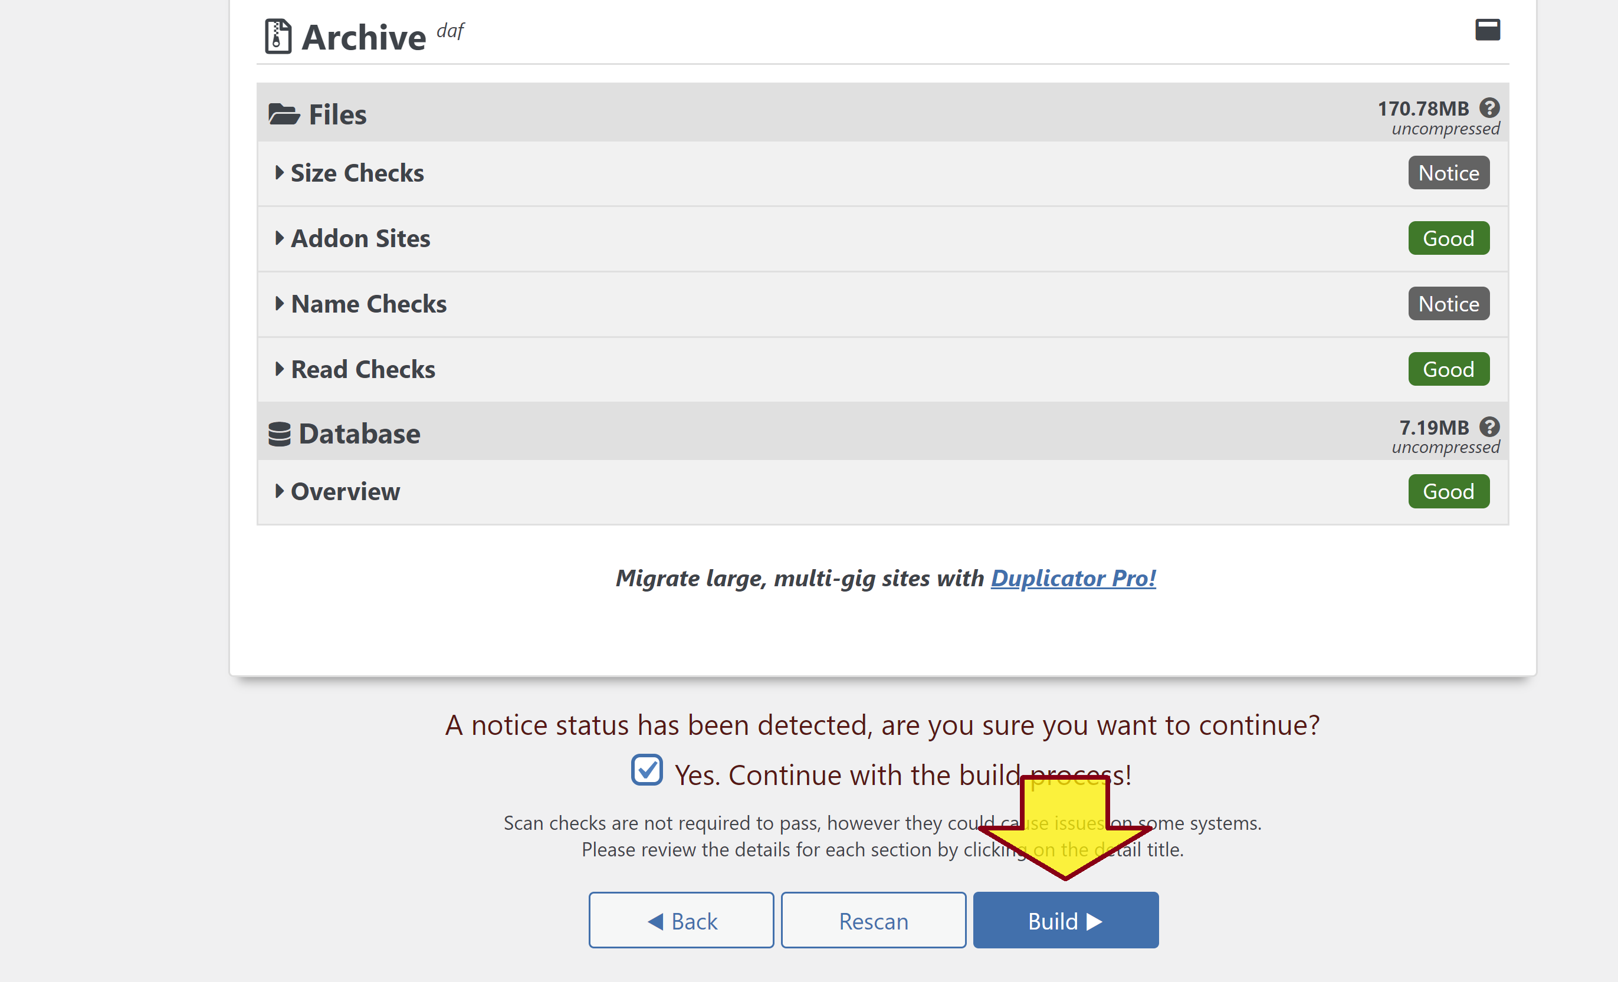
3. Build the Package

Slide 8
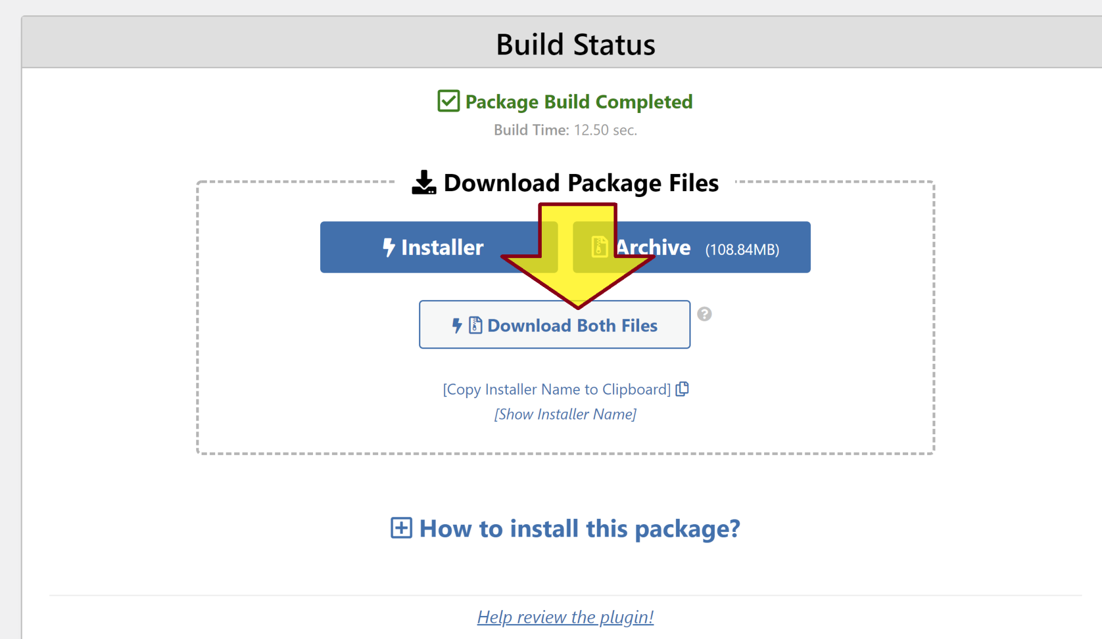
4. Download the Package

Slide 9
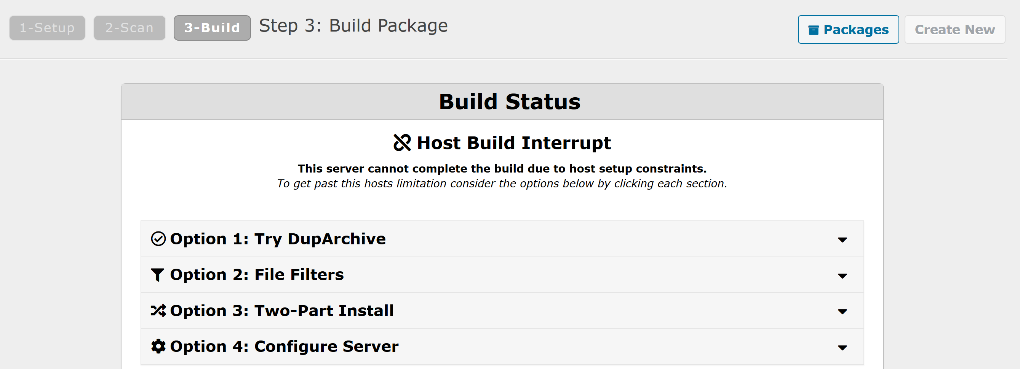
Issue: Host Build Interrupt

Slide 10
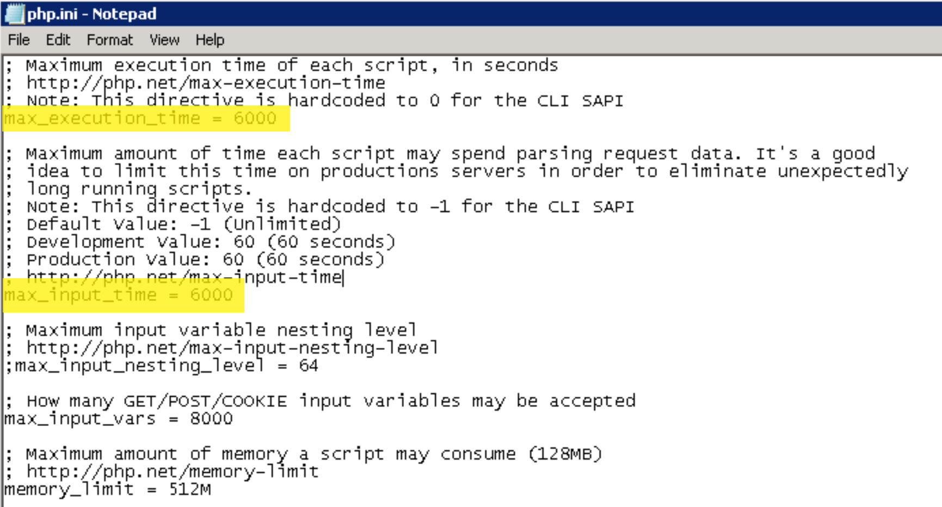
Solution for: Host Build Interrupt
Temporarily set max_execution_time and max_input_time to 6000 or 0 in php.ini.
Try restarting the machine if the issue still persists.

Slide 11


Slide 12
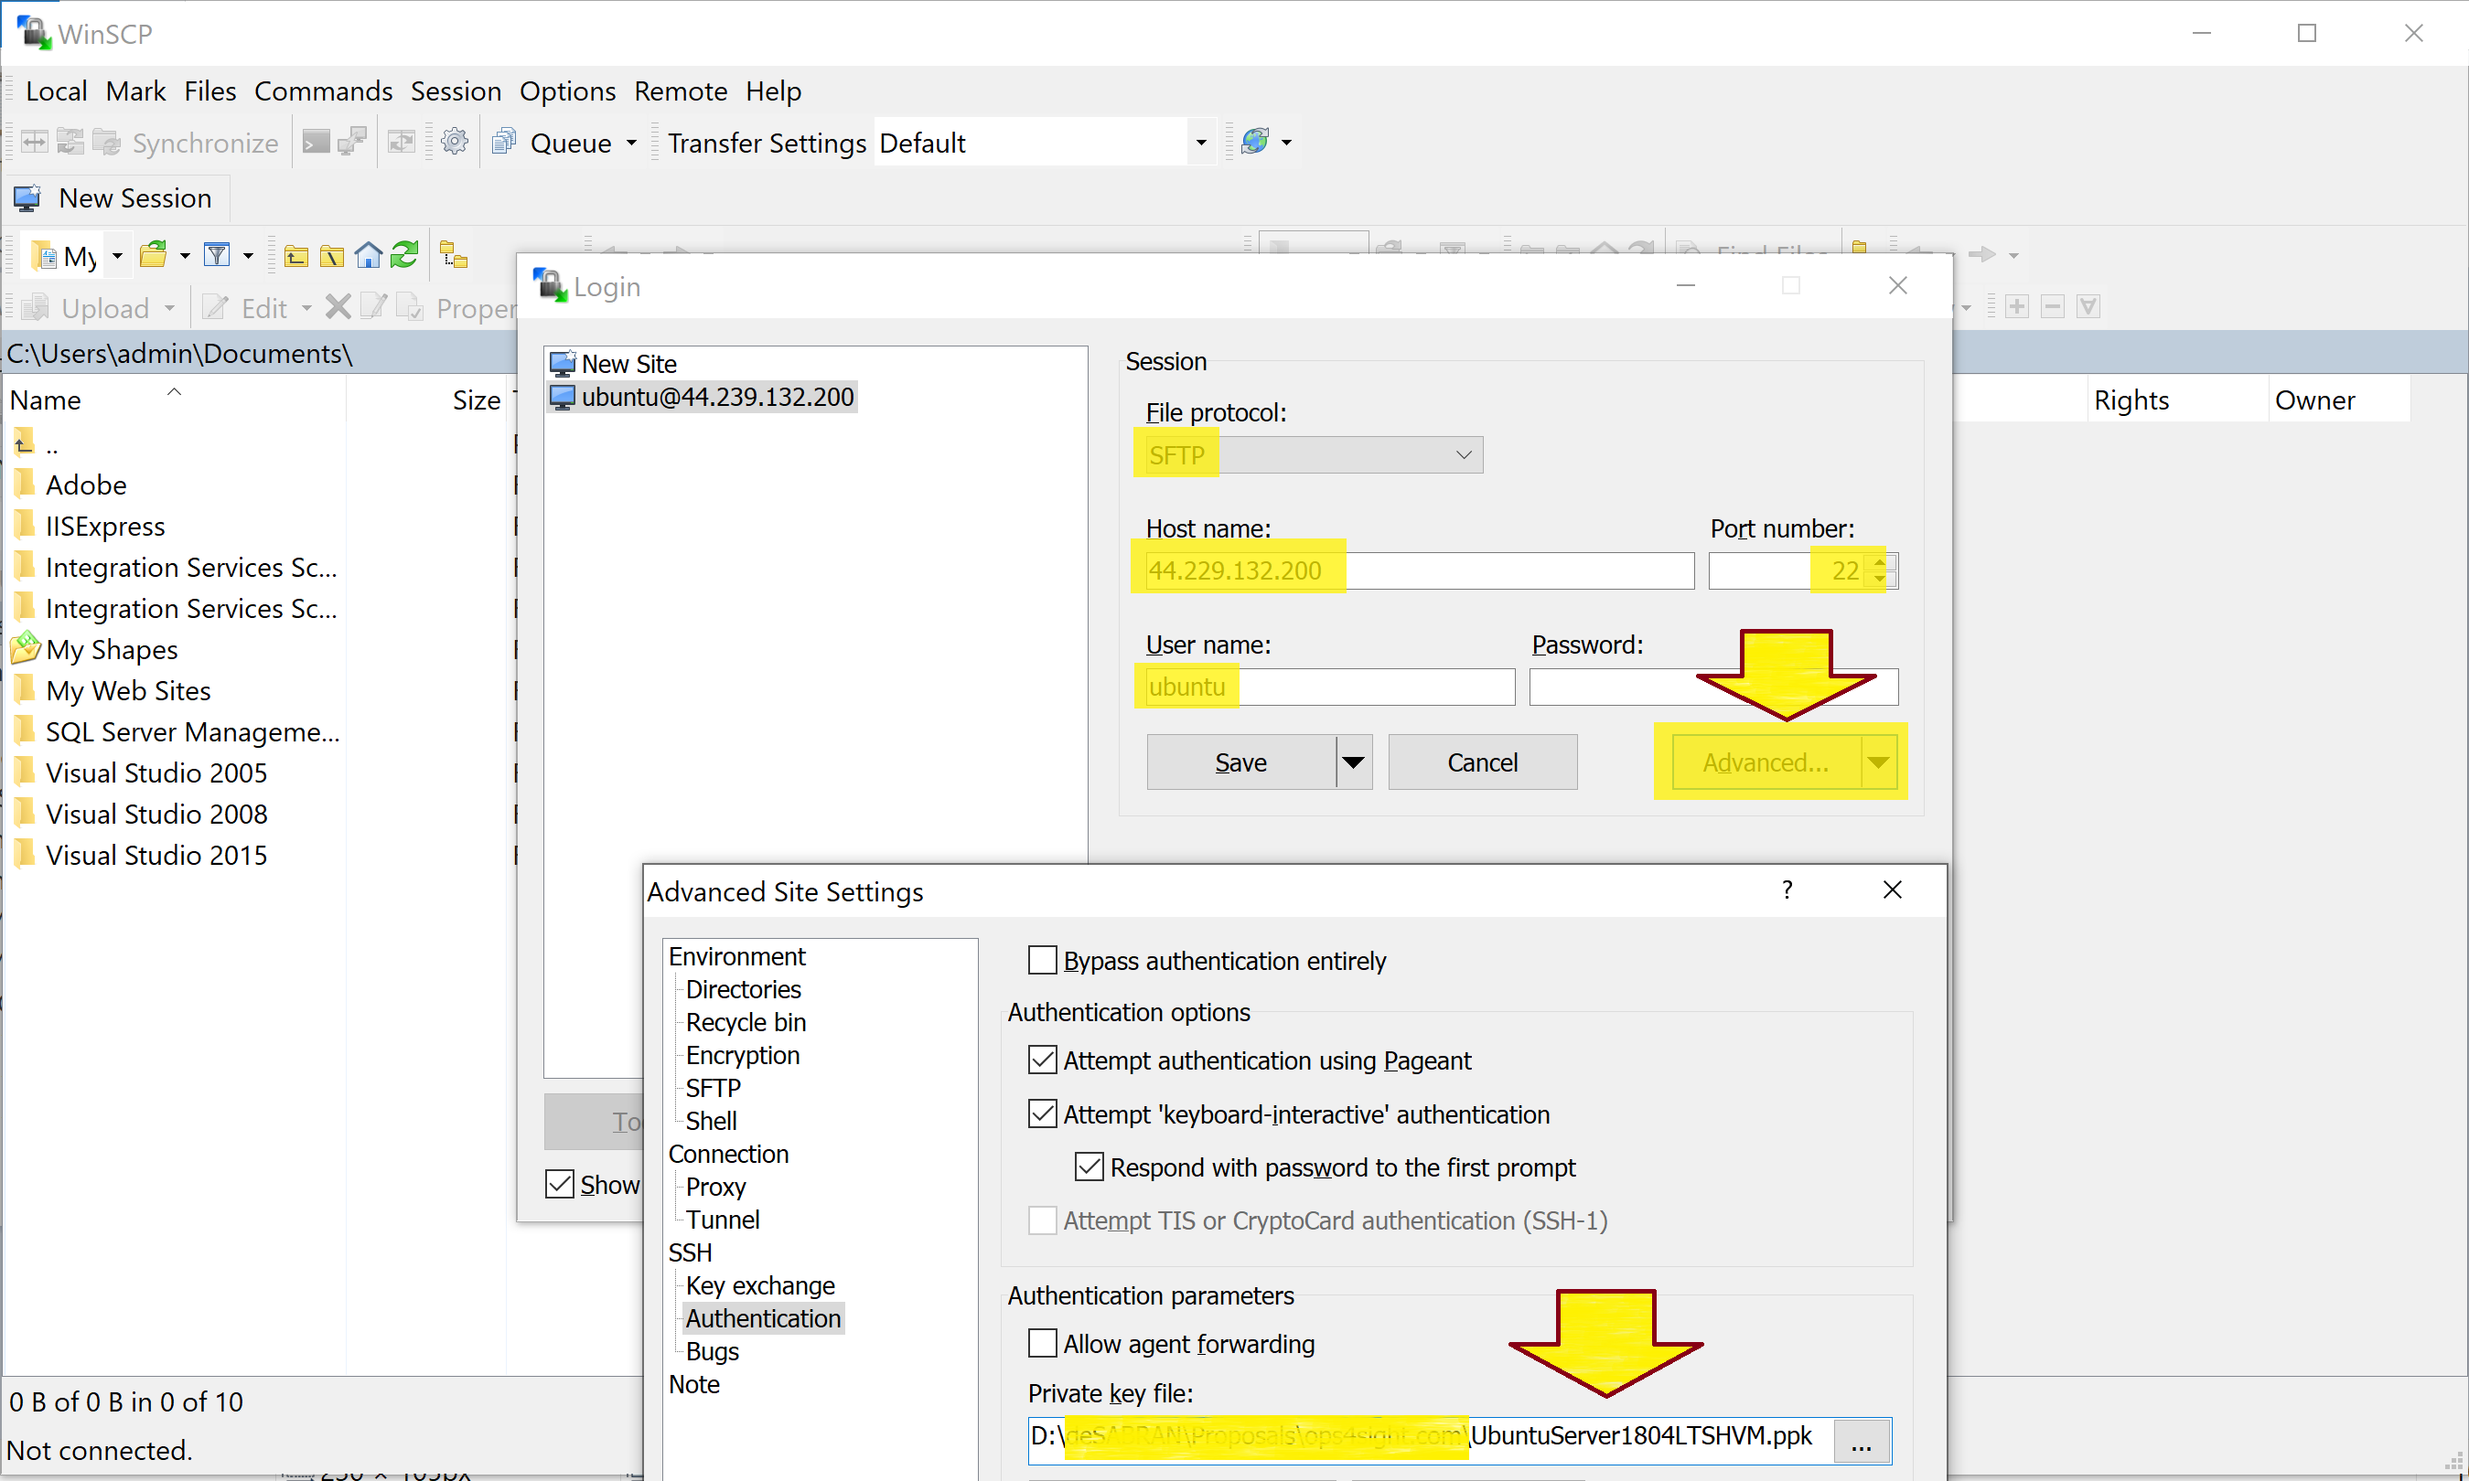
1. Copy the package (.zip) and the installer.php file to Destination Server

Slide 13
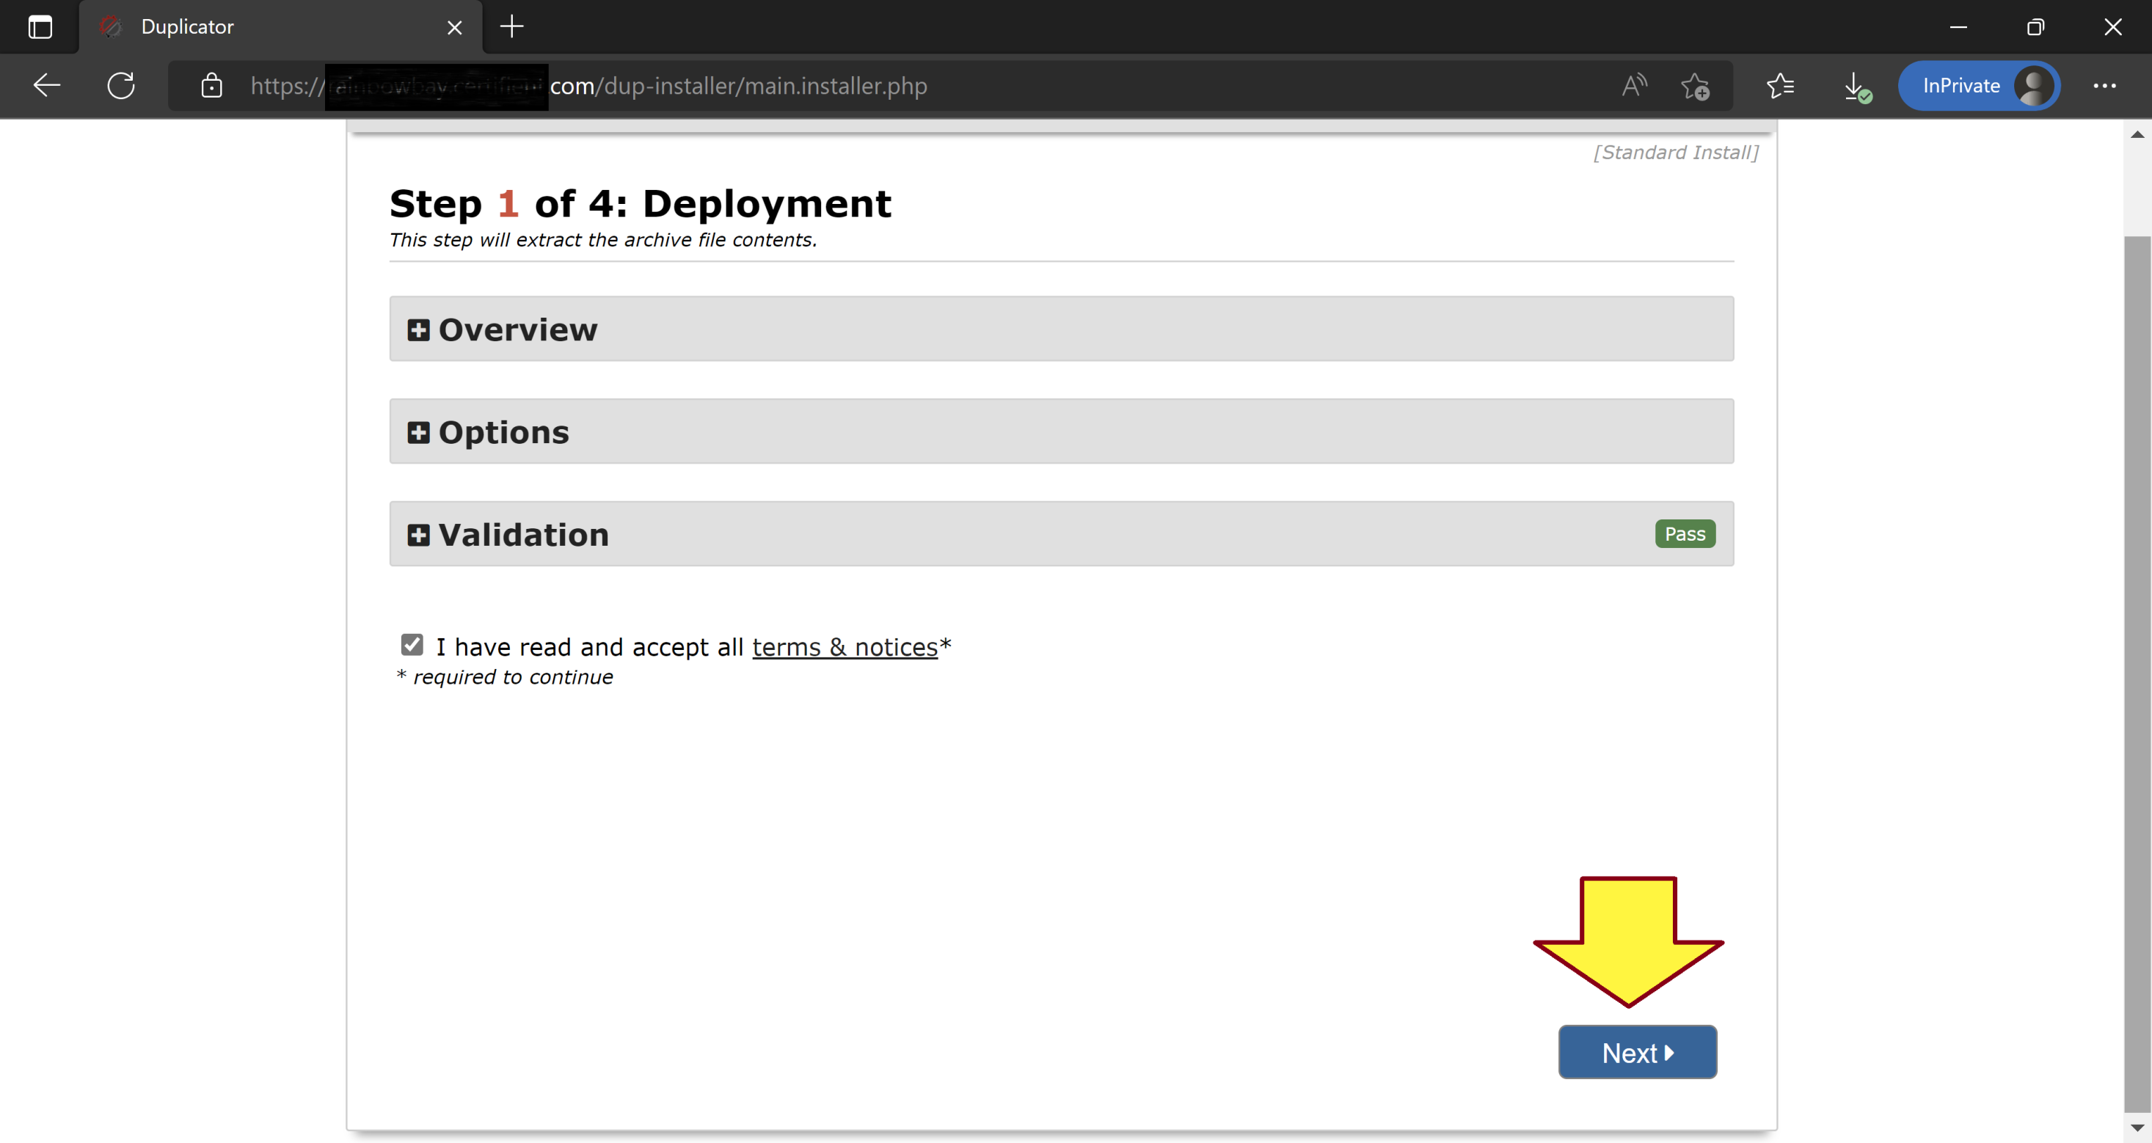
2. Restore the Website
Open https://example.com/installer.php.

Slide 14
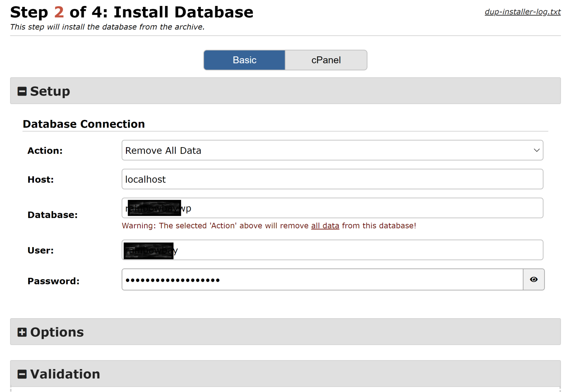
3. Enter Database Information

Slide 15
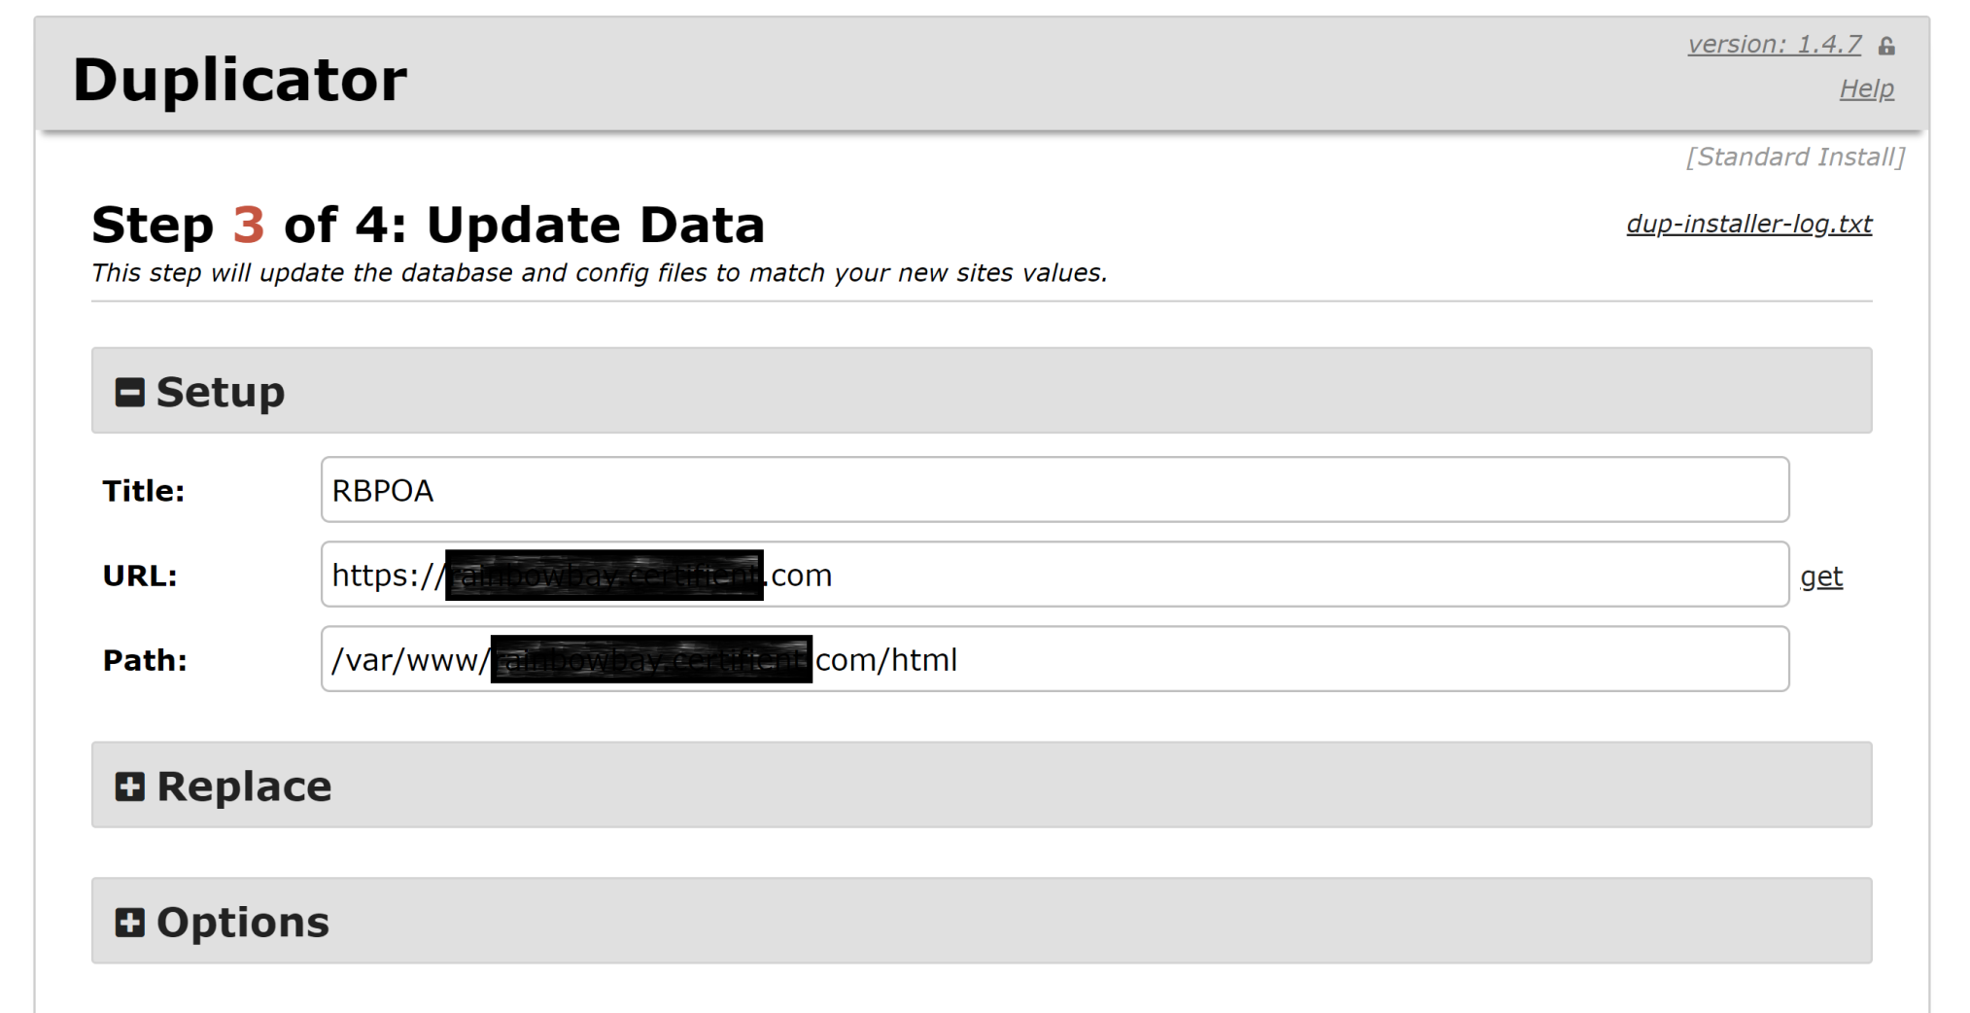
4. Update Data

Slide 16
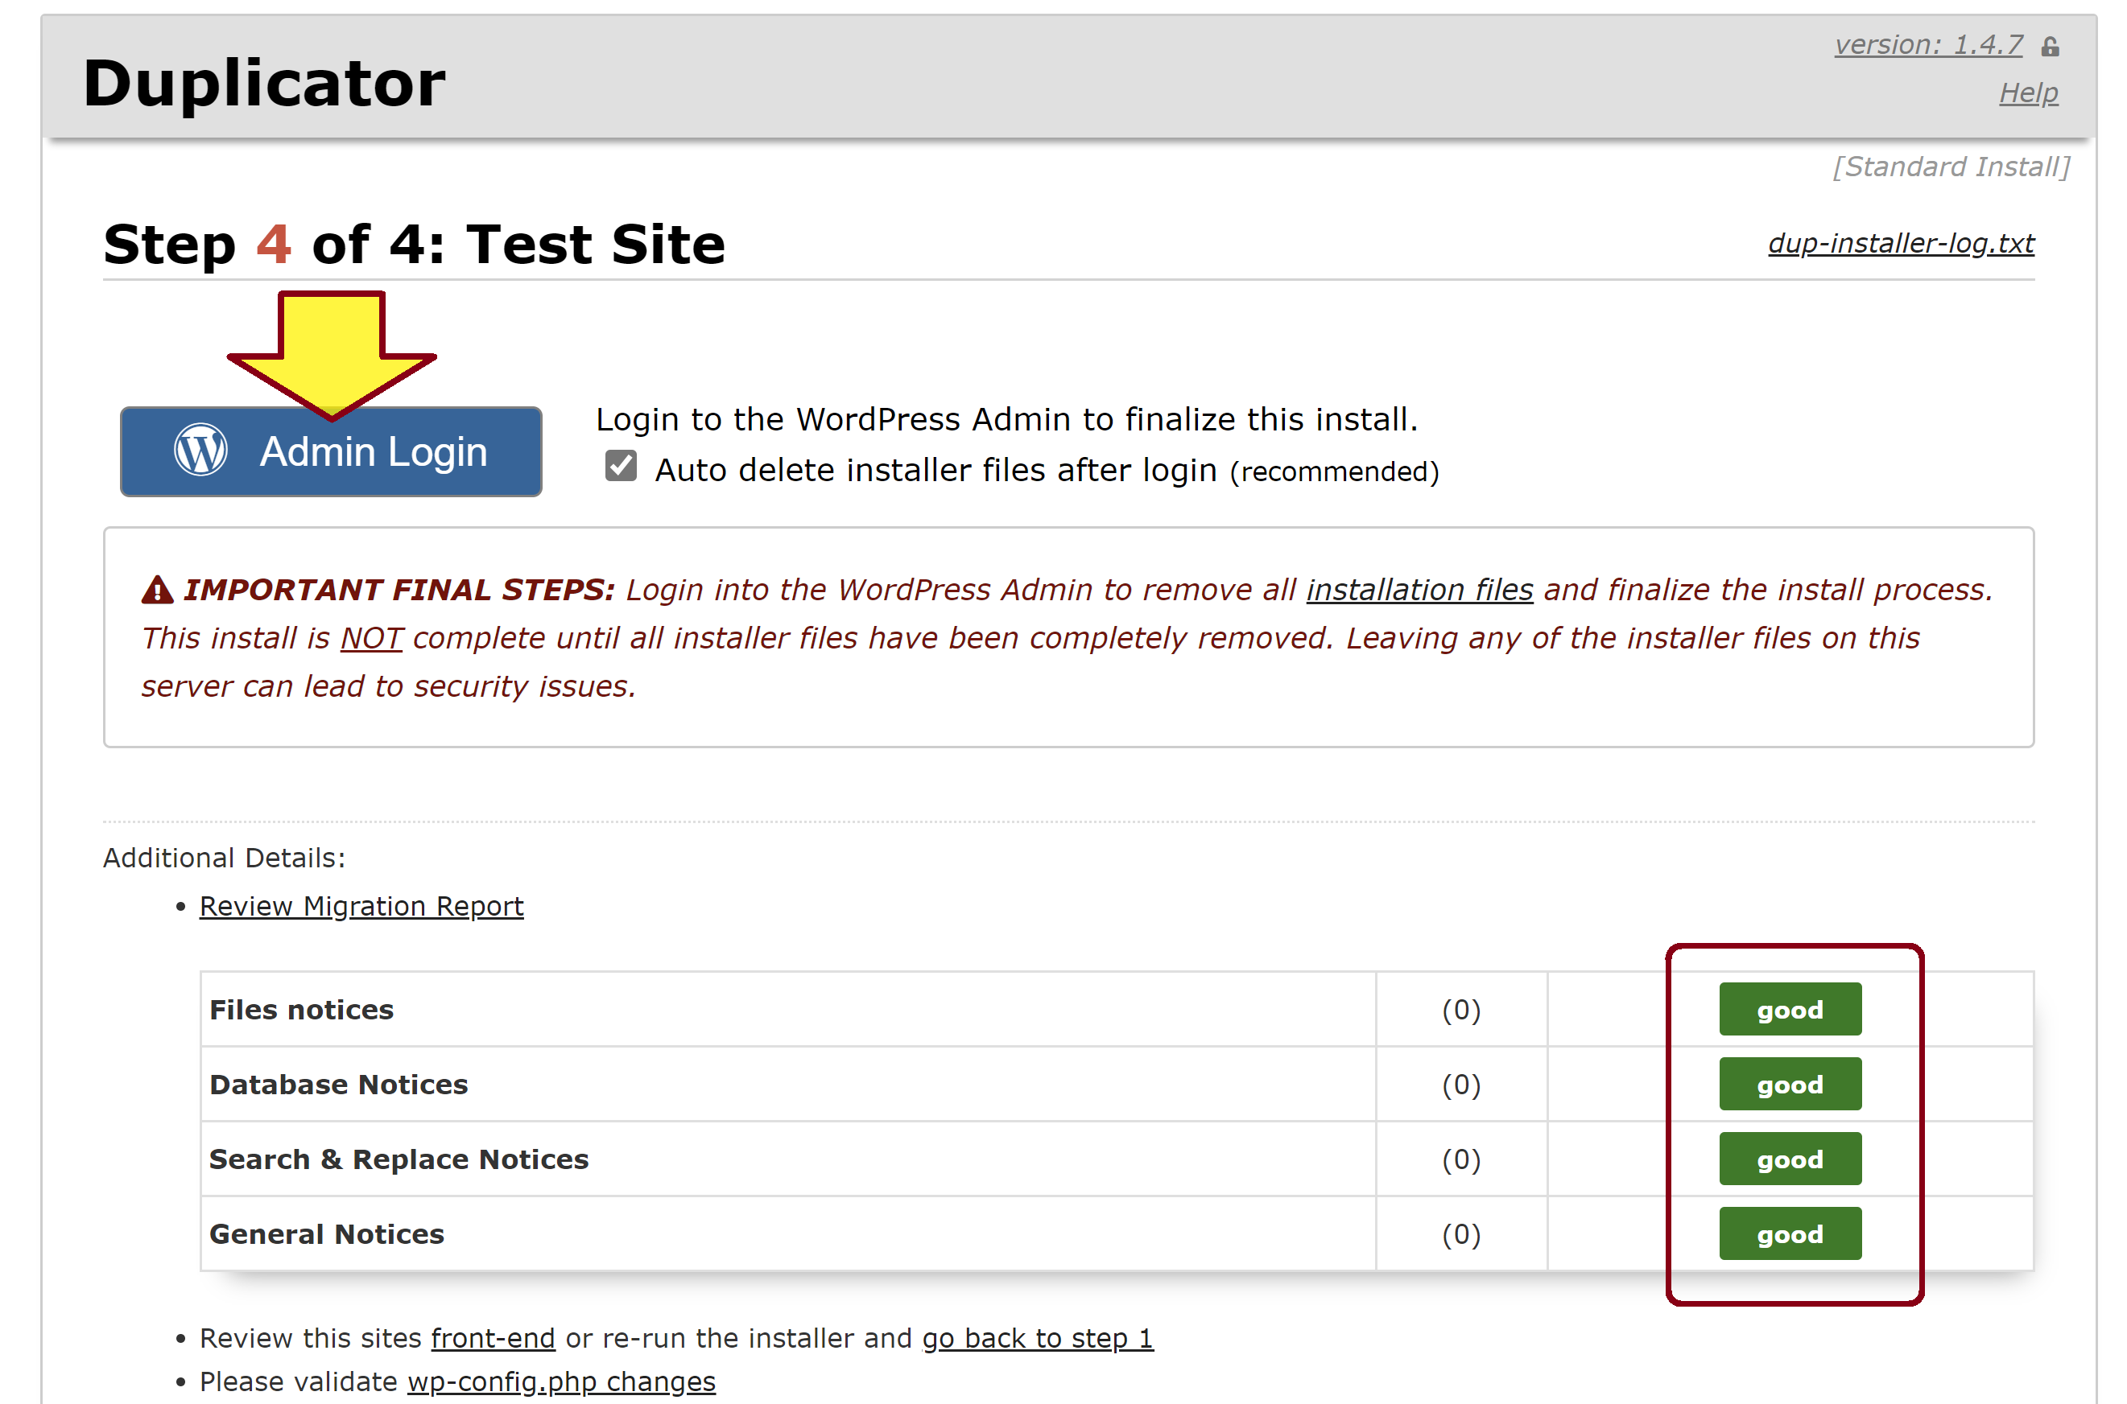
5. Review Result

Slide 17
Fix “utf8mb4_0900_ai_ci” Collation Error
Upgrade MySQL 5.7 to MySQL 8.0

Slide 18
6. Enable Permalinks for Nginx
sudo nano /etc/nginx/sites-available/Example-Com.org
. . .
server {
root /var/www/Example-Com.org/html;
index index.php index.html index.htm index.nginx-debian.html;
server_name Example-Com.org www.Example-Com.org;
if (!-e $request_filename) {
rewrite ^.*$ /index.php last;
}
. . .
sudo nginx -t
sudo systemctl reload nginx

Slide 19
7. Remove the Old Website
Remove all existing files and folders
sudo rm -rf /var/www/domain.com/html/*
Set write permissions for the root folder
sudo chmod -R 777 /var/www/example.com
Reset database
mysql -u root –p
DROP DATABASE `example-comwp`;
DROP USER 'example-com'@'localhost';
CREATE USER 'example-com'@'localhost' IDENTIFIED BY 'Example-Com@20220710';
CREATE DATABASE `example-comwp`;
GRANT ALL PRIVILEGES ON `example-comwp`.* TO "example-com"@"localhost";
FLUSH PRIVILEGES;
exit;

Slide 21
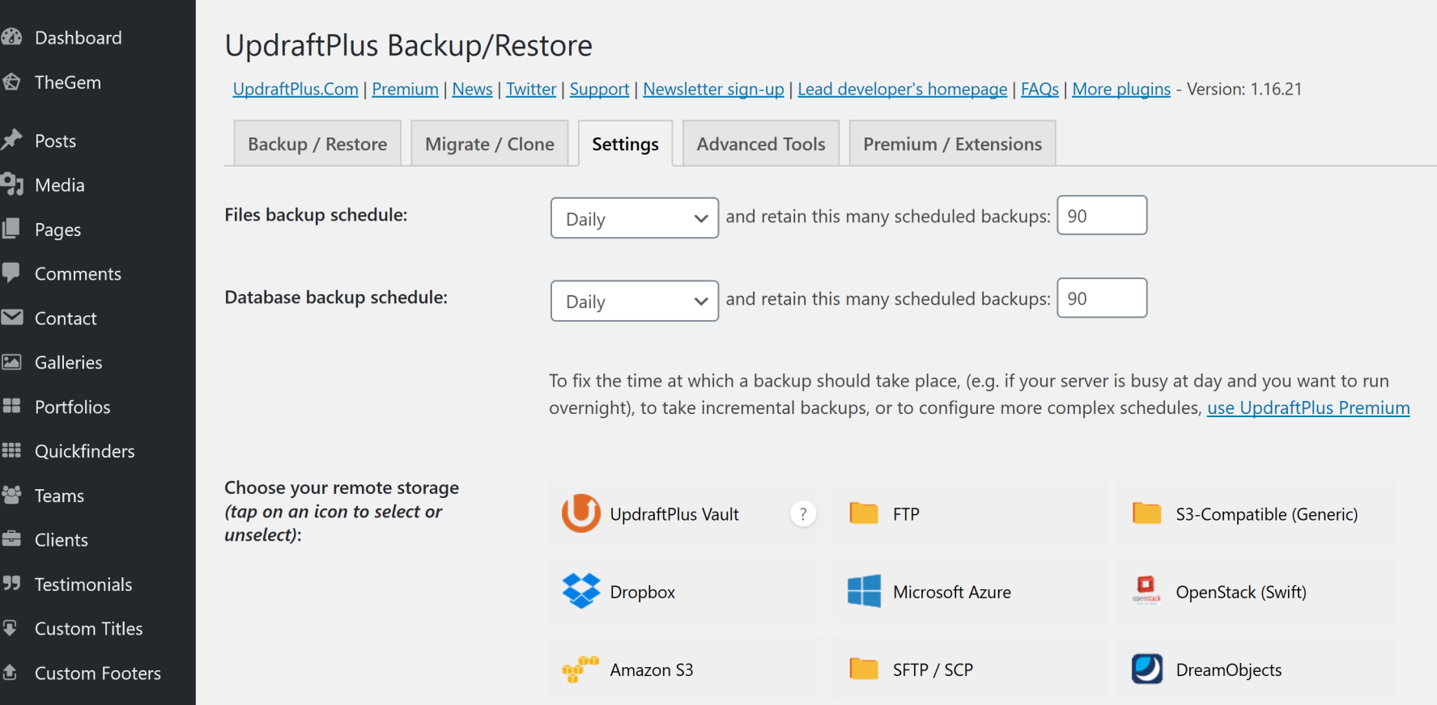
1. Install the UpdraftPlus Plugin

Slide 22
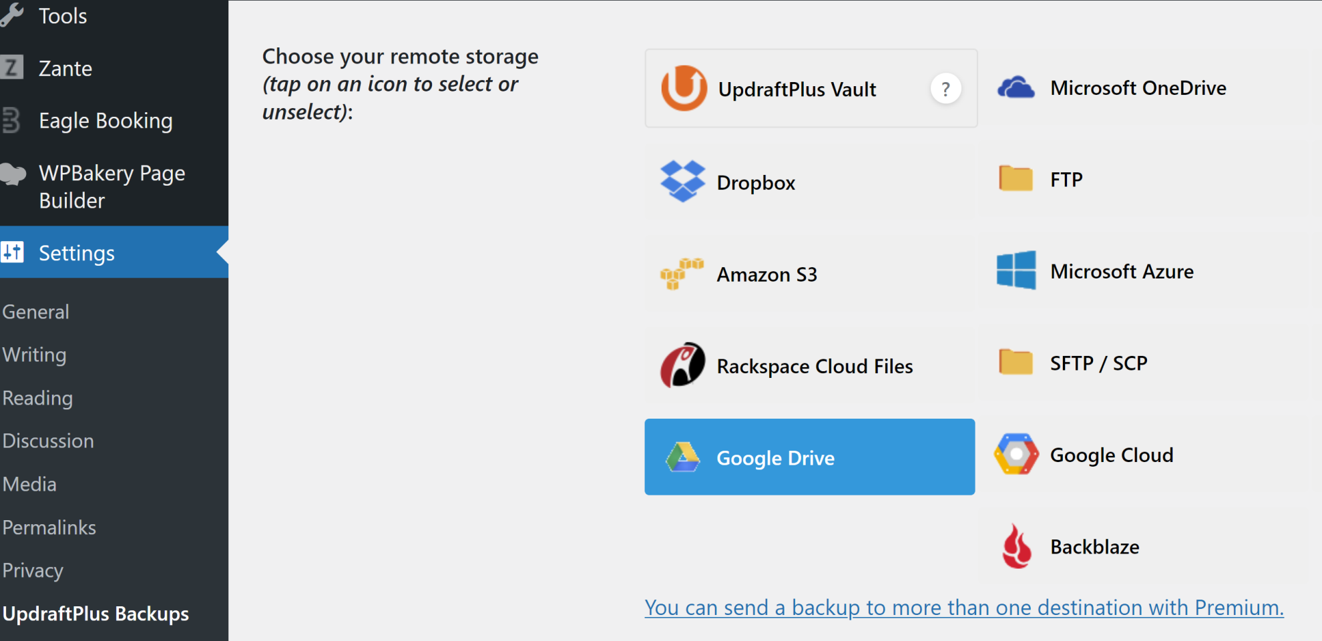
2. Select Remote Storage

Slide 23
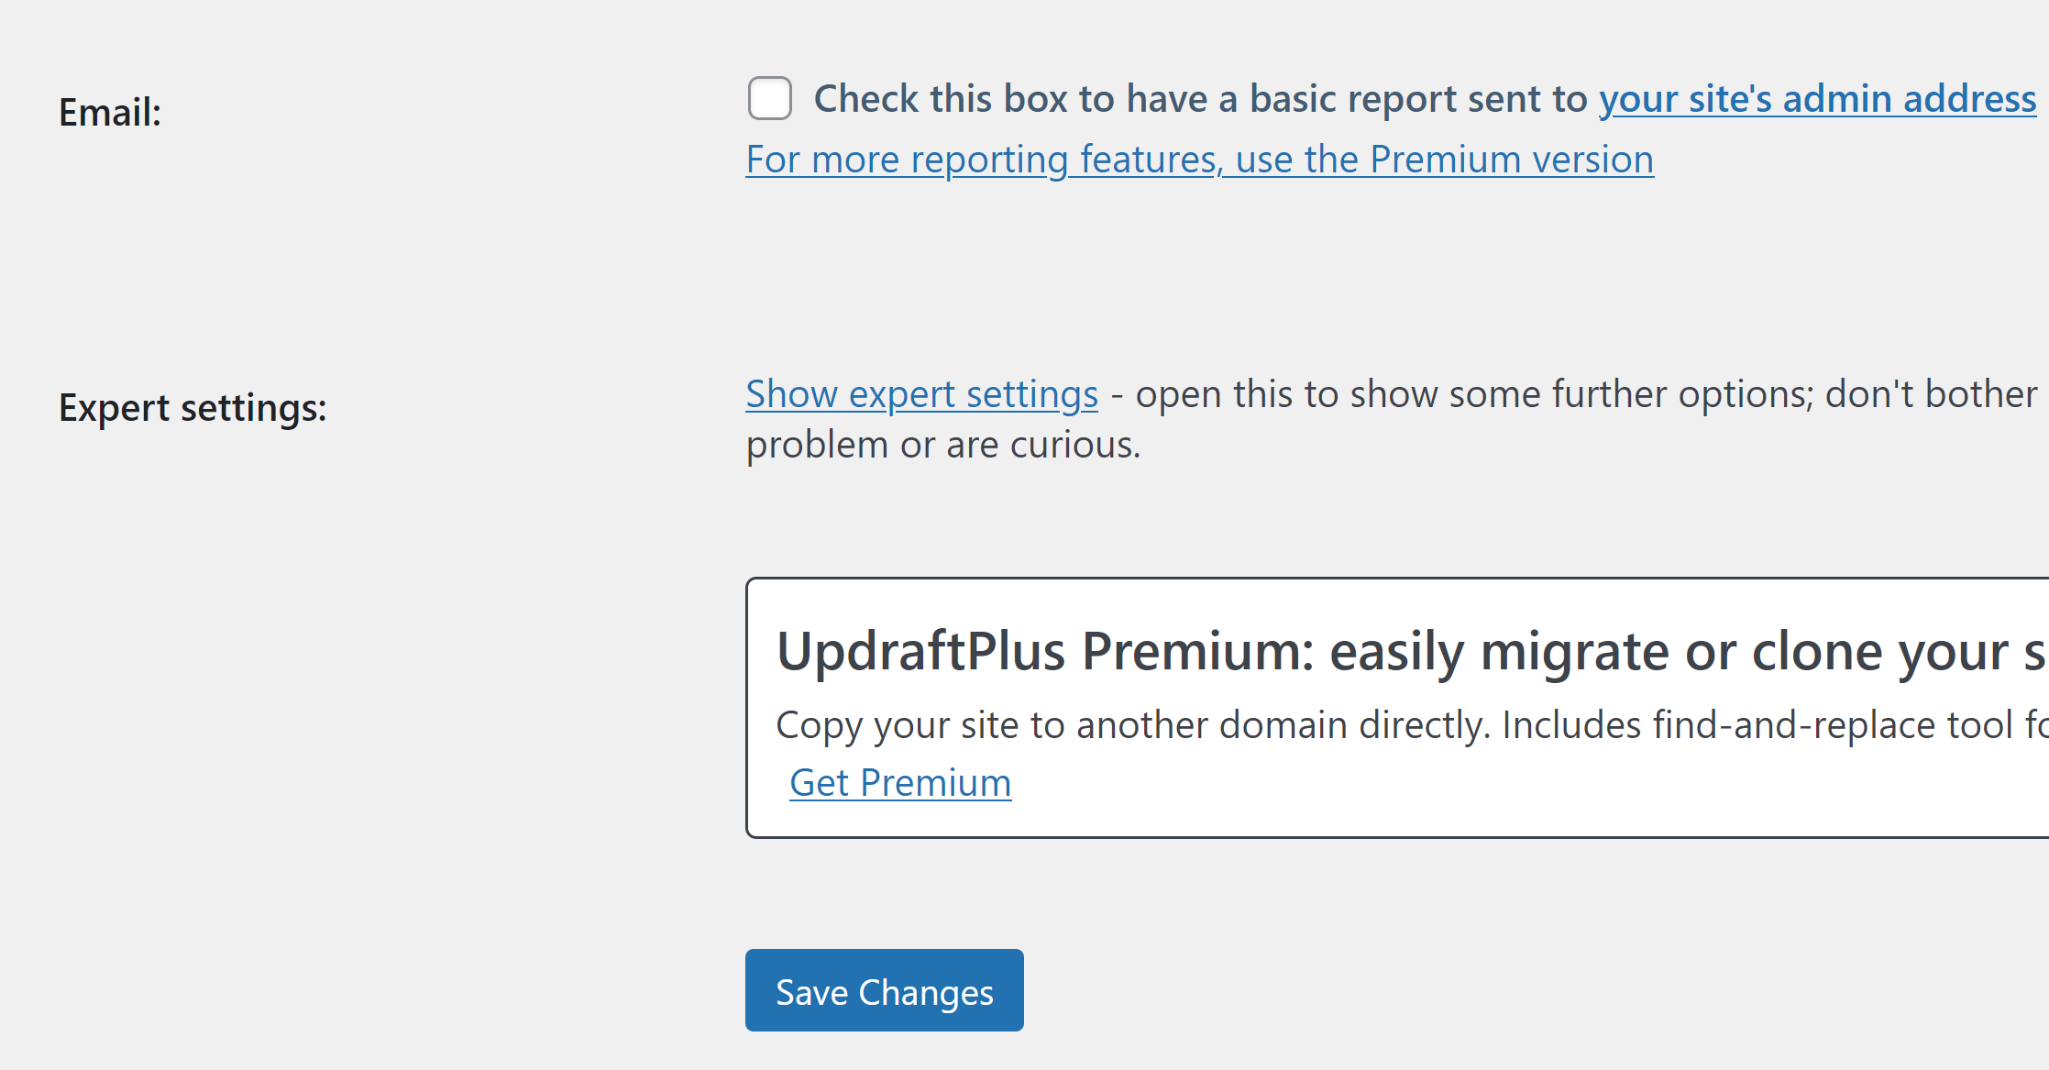
3. Save the Change

Slide 24
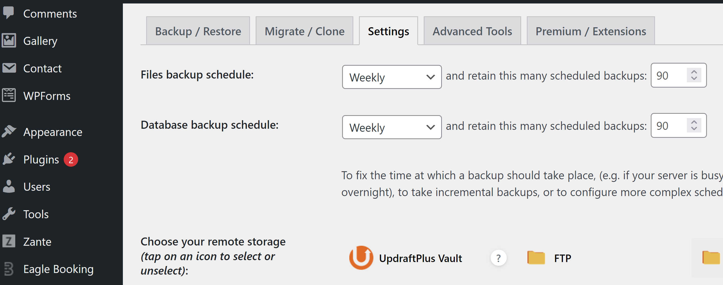
4. Select Backup Schedule

Slide 25
5. Delete Local Files
cd /var/www/example.com/html/wp-content/updraft
ls
sudo rm -rf *
ls

Slide 27
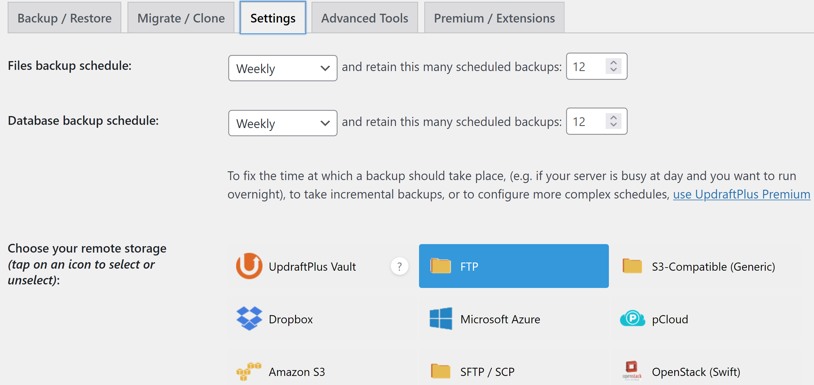
1. Select FTP Remote Storage

Slide 28
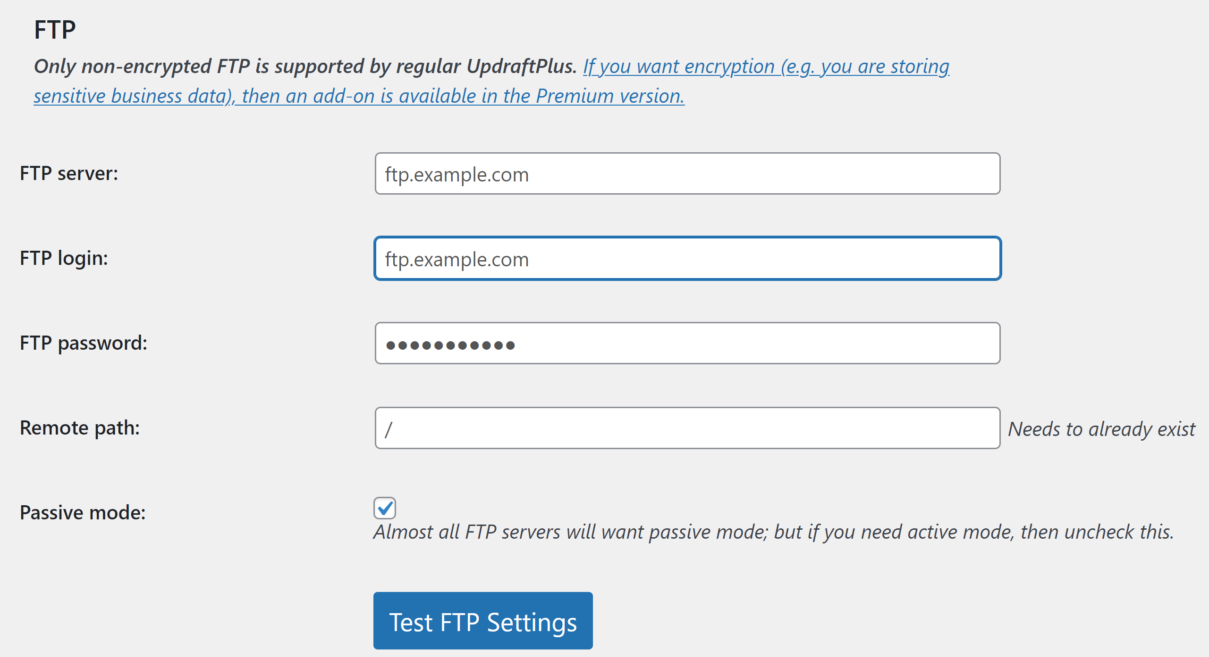
2. Enter the FTP Information

Slide 30
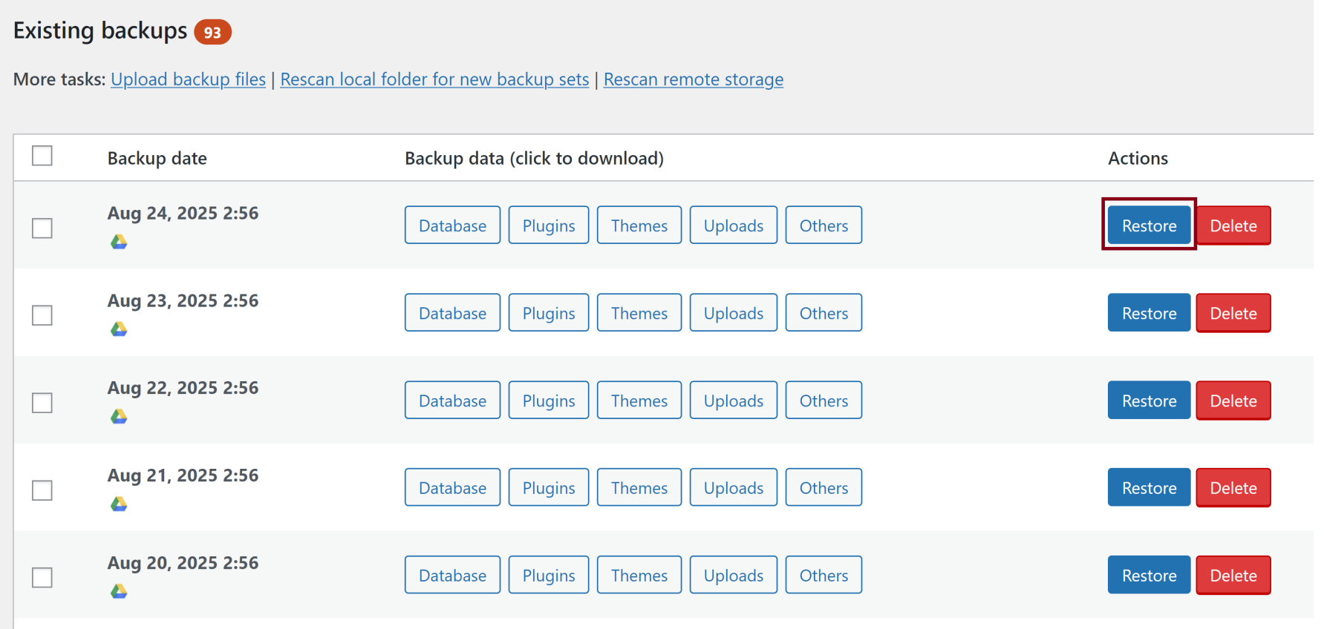
1. Select a Backup for Restoration
Ensure that the WordPress version matches the version used to create the backup.

Slide 31
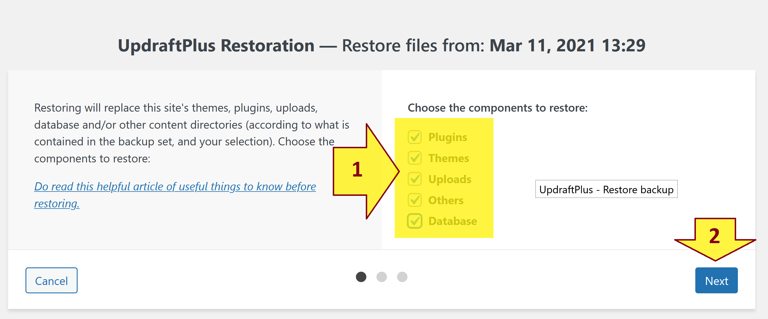
2. Select Components

Slide 32
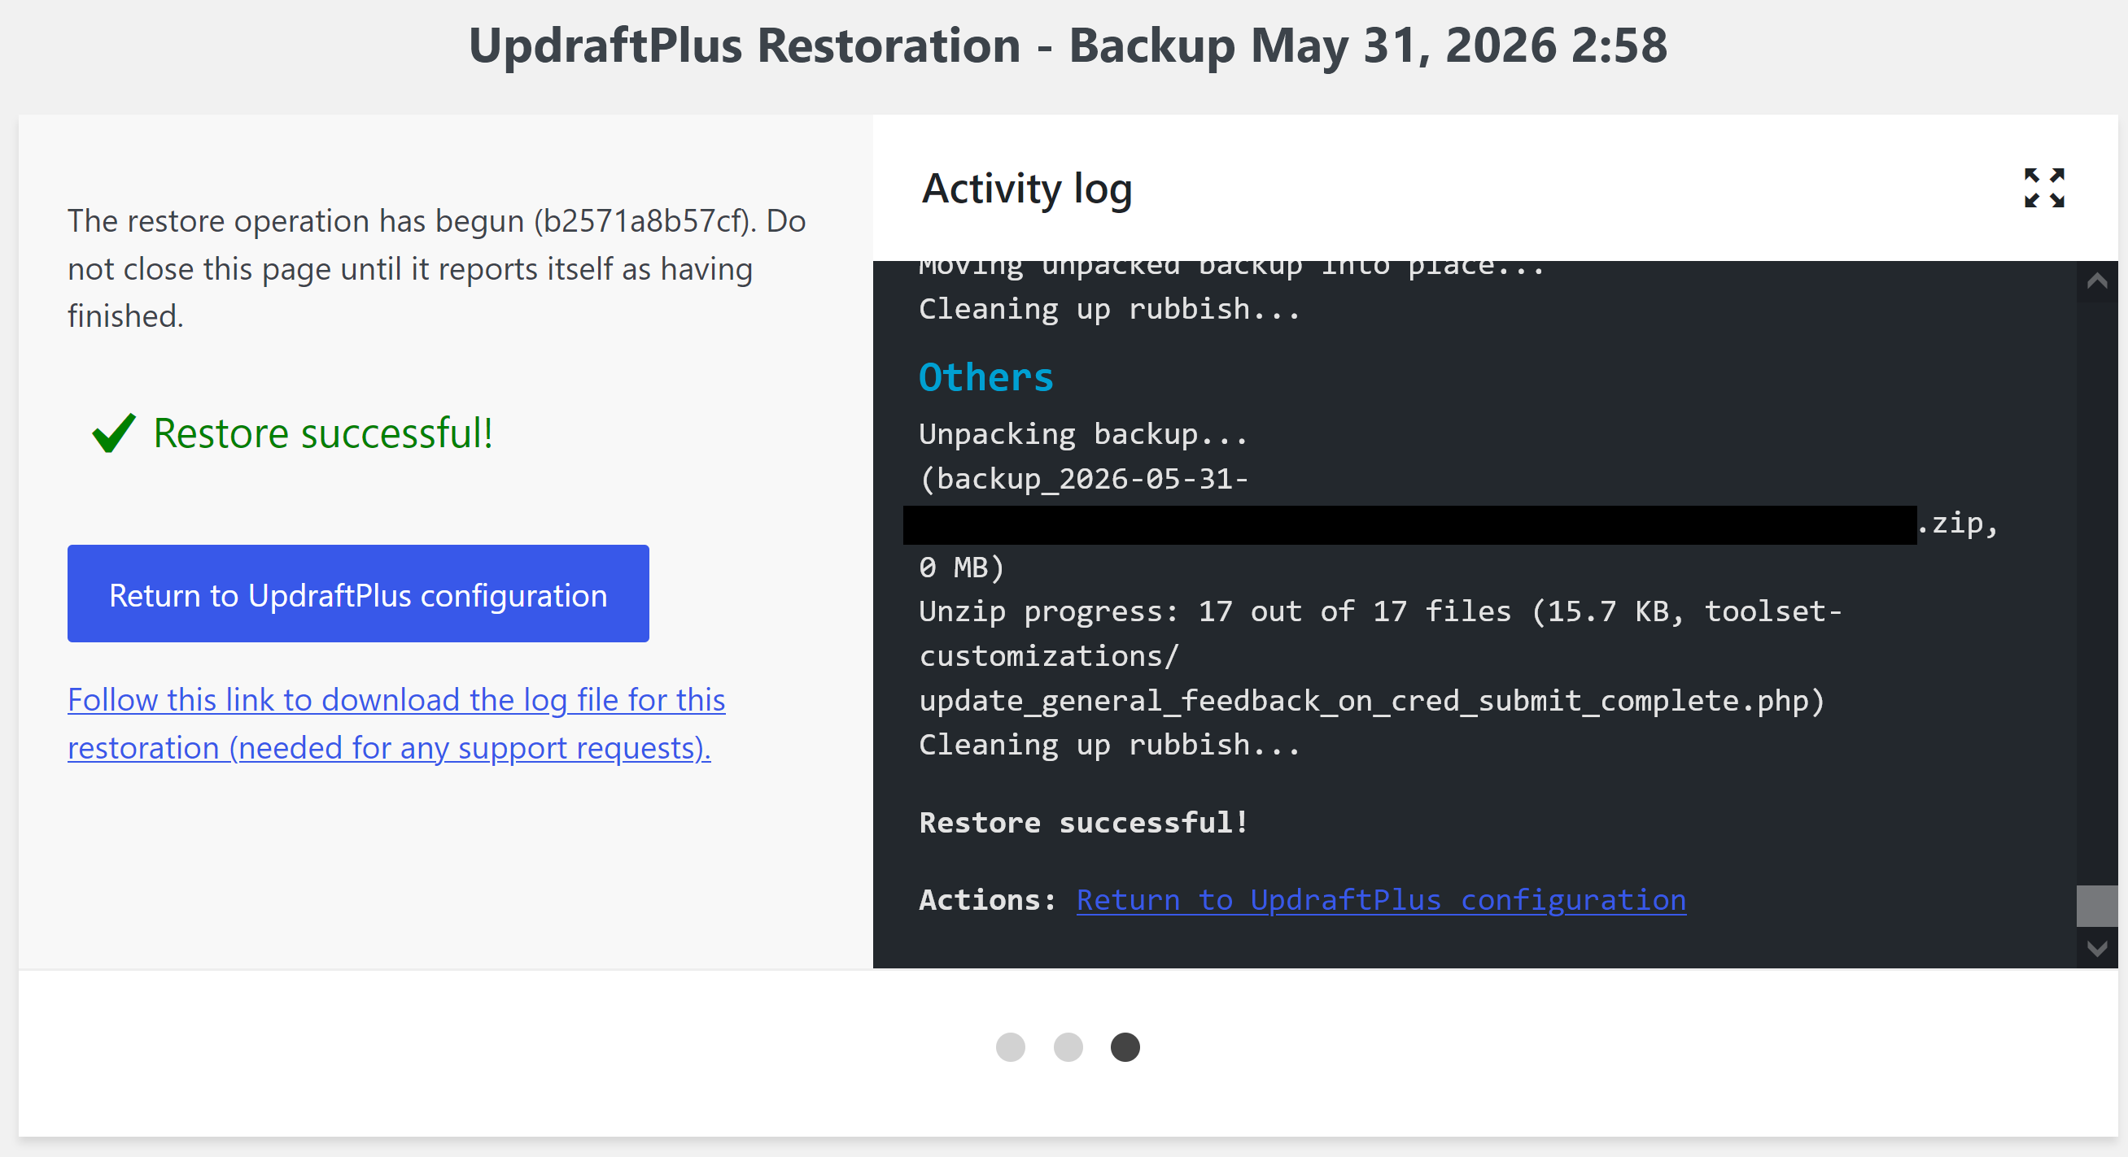
3. Confirm Restoration Success

Slide 34
1. Move Website Manually
Backup the source code
cd /var/www/example.com
sudo zip -r html.zip html
Backup database
mysqldump -u root -p -h localhost examplewp > examplewp.sql ( root / ********** )
Create nginx website
Restore the database
mysql -u root -p -h localhost examplewp < examplewp.sql
Unzip the source code
sudo unzip html.zip

Slide 35
2. Change the Website's Domain
Open the wp-config.php file.
Add two lines to the file, right before /* That’s all, stop editing! Happy blogging. */:
define('WP_HOME','https://example.com');
define('WP_SITEURL','https://example.com');
Bulk edit the posts content if necessary.

Slide 36
3. Bulk Edit Content
mysql -u root -p
use new_namewp;
UPDATE wp_options SET option_value = replace(option_value, 'https://old_name.com', 'https://new_name.com') WHERE option_name = 'home' OR option_name = 'siteurl';
UPDATE wp_posts SET guid = replace(guid, 'https://old_name.com','https://new_name.com');
UPDATE wp_posts SET post_content = replace(post_content, 'https://old_name.com', 'https://new_name.com');
UPDATE wp_postmeta SET meta_value = replace(meta_value,'https://old_name.com','https://new_name.com');
exit

Slide 38
1. Archive a Website (I)
Backup the source code
cd /var/www/example.com
ls
sudo zip -r html.zip html
Backup database
mysqldump -u root -p -h localhost examplewp > examplewp.sql ( root / ********** )
Download html.zip and examplewp.sql file.
Remove files
sudo rm -rf html.zip
sudo rm -rf examplewp.sql

Slide 39
2. Archive a Website (II)
Remove certificate
sudo certbot delete
Remove website
cd /var/www/
sudo rm -rf example.com
Remove database
mysql -u root -p
SHOW DATABASES;
DROP DATABASE `examplewp`;
SELECT Host, User, plugin from mysql.user;
DROP USER 'example'@'localhost';
exit;

Slide 40
3. Archive a Website (III)
Disable the website
cd /etc/nginx/sites-enabled
ls
sudo rm example.com
sudo nginx -t
sudo service nginx reload
Download the website configuration file in /etc/nginx/sites-available/
Remove the website configuration file
cd /etc/nginx/sites-available/
ls
sudo rm -rf example.com
ls

Slide 41

Thank You & See You Again

